Slide 1
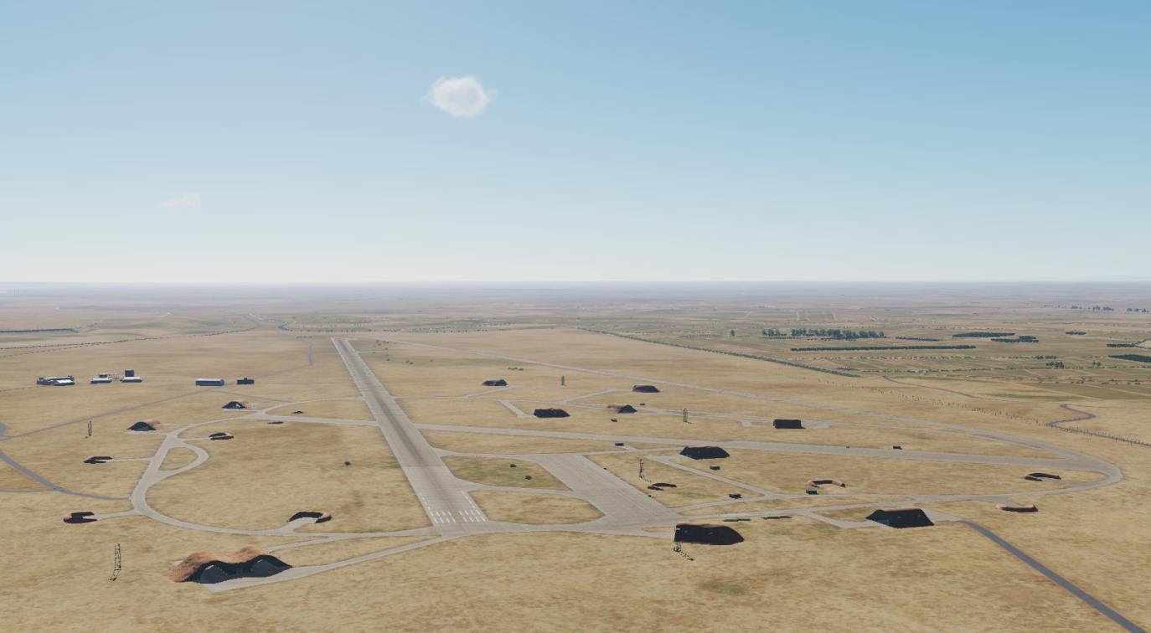

OPARTGT039 Jirah Airbase
N
39
DESCRIPTION OF THE DESIRED POINTS OF IMPACT WITH WPN TYPE:
OPARTGT039 – Jirah Airbase
DPI 1 N36 05.946 E037 55.267/1138ft/(500 Ibs bomb)
DPI 2 N36 05.882 E037 55.748/1152ft/(500 Ibs bomb)
DPI 3 N36 05.759 E037 56.558/1165ft/(500 Ibs bomb)
DPI 4 N36 05.726 E03756.784/1168ft/(500 Ibs bomb)
DPI 5 N36 05.669 E037 57.165/1171ft/(500 Ibs bomb)
DPI 6 N36 05.834 E037 56.929/1168ft/(500 Ibs bomb)
DPI 7 N36 05.973 E037 57.090/1171ft/(500 Ibs bomb)
DPI 8 N36 06.058 E037 56.889/1161ft/(500 Ibs bomb)
DPI 9 N36 06.043 E037 56.373/1161ft/(500 lbs bomb)
DPI 10 N36 06.025 E037 55.787/1152ft/(500lbs bomb)
4
5
6
7
8

Slide 2
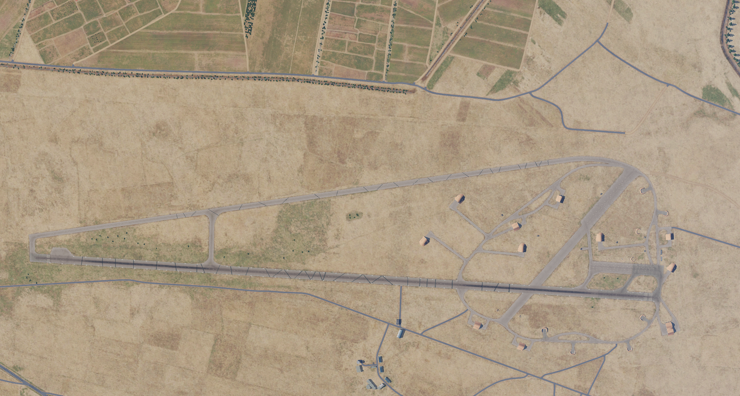
OPARTGT039 Jirah Airbase DPIs
N
1
8
9
7
10
6
1
2
3
4
5

